Slide 1

Setting the Vision
A Biblical overview of grandparenting
OLLY GOLDENBERG • NCGC 2026

Slide 2


Slide 3


Slide 4


Slide 5


Slide 6


Slide 7


Slide 8


Slide 9
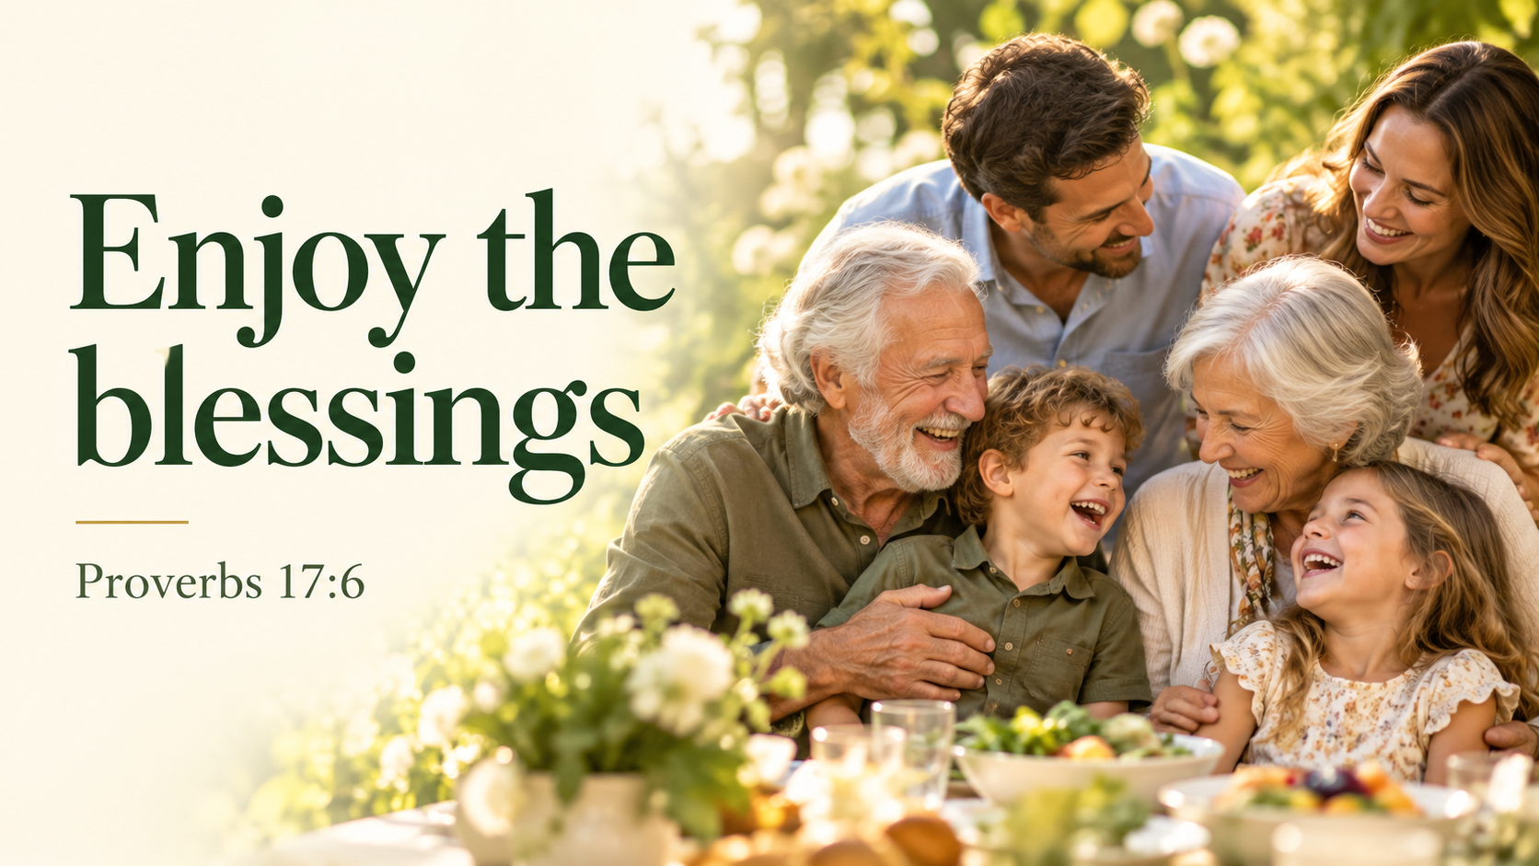

Slide 10


Slide 11


