Slide 1

Session 2: Facing the Challenges
AND Reasons for Hope
Becky Sedgwick & Sarah Holmes
• NCGC 2026

Slide 2
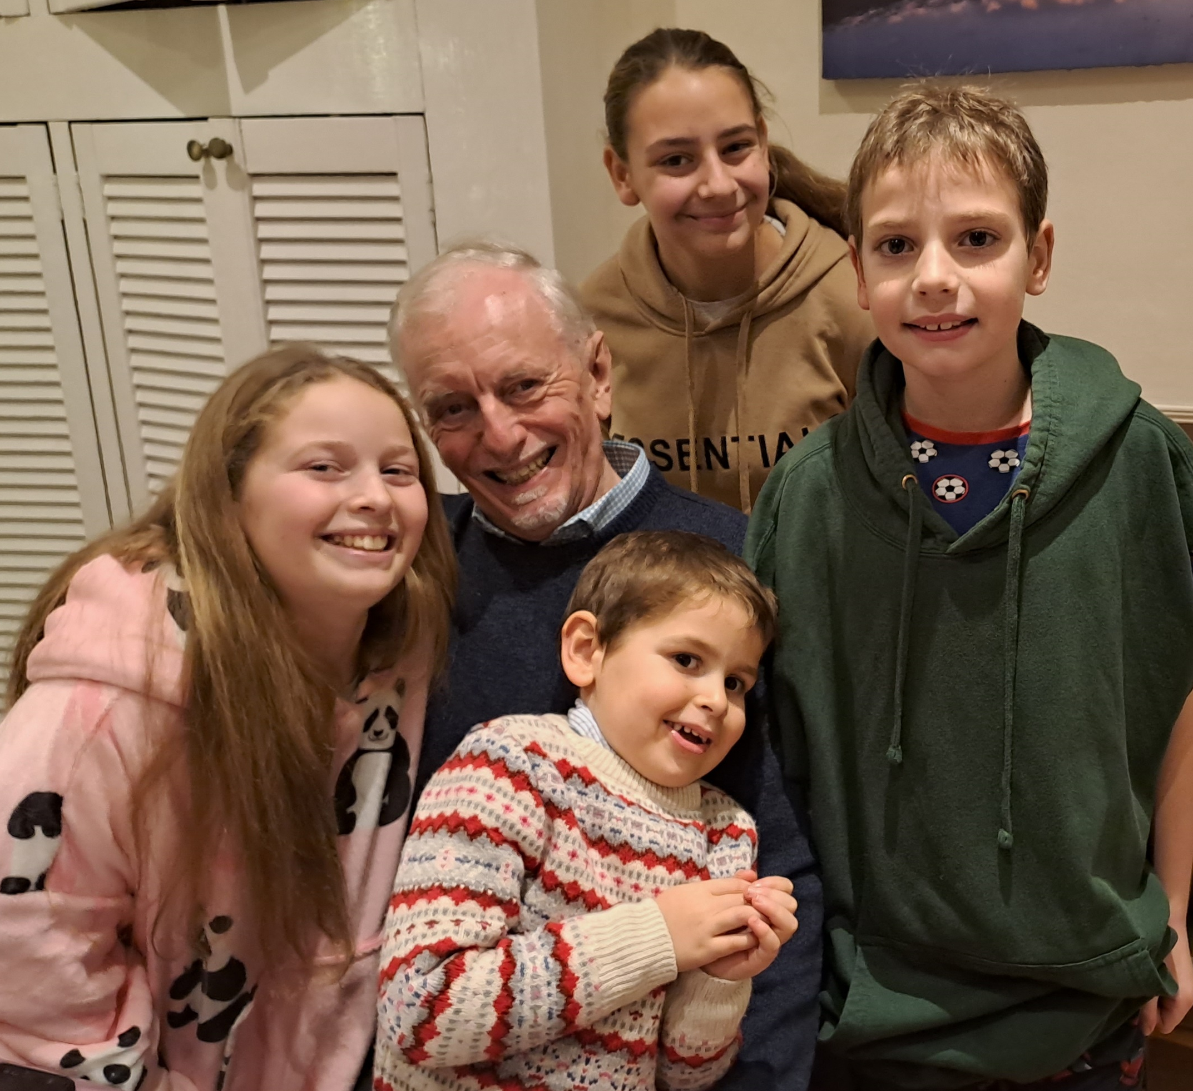
Some ideas in literature
Grandparents are widely viewed as beneficial, partly due to the special nature of the grandparent-grandchild relationship (Rempel, 2012).
Unique & natural connection of grandparents & grandchildren (Kimmel & Kimmel, 2007).
The relationship is often close & satisfying for both generations (Sciplino & Kinshott, 2019).
Unique set of historical & experiential events that shape interactions (Hagestad, 1985).
Mutual satisfaction & meaningful attachment bond (Condon et al. 2020).
Emotional closeness, shared family identity, and perceived availability of social support (Mansson, Floyd & Soliz, 2017).
THE NATIONAL CHRISTIAN GRANDPARENTS CONFERENCE

Slide 3
Some ideas in literature
Spiritual value of grandparents (Allen, 2007).
Intergenerational relationships have capacity to nurture spiritual growth and development in both adults and children (Clark, 2013).
Collaborate towards spiritual wellbeing of grandchildren (Kimmel & Kimmel, 2007).
Grandparent’s role in family religious life is companionship, spiritual authority, & passing on faith (Simmons, 1997).
Passing on faith occurs through participation, reflection, rituals & storytelling (Allana, 2017).
There are limitations to influence of grandparents, eg, their attitude, resources, & time (Deprez, 2017).
THE NATIONAL CHRISTIAN GRANDPARENTS CONFERENCE

Slide 4


Initial Exploratory Study (2022)
Grandparent focus groups (n=22)
Christian media (n=7), resourcing orgs (n=6) and denominations (n=11)
Taking the Pulse (2024)
Online survey of Christian grandparents (n=140)
Grandparenting for Faith courses (2025-2026)
Course for Christian grandparents and grandparent-figures
Course for church leadership
Church representatives focus groups (n=17)

Slide 5
Reflections from Christian grandparents...
How do they see their role?
Some said they felt:
Passive agents, with background involvement
Very involved in discussions about faith
Heritage & foundation of family faith identity
Excluded & uninvolved
Lacked confidence
Uncertain of boundaries
(Holmes, 2022)
THE NATIONAL CHRISTIAN GRANDPARENTS CONFERENCE

Slide 6
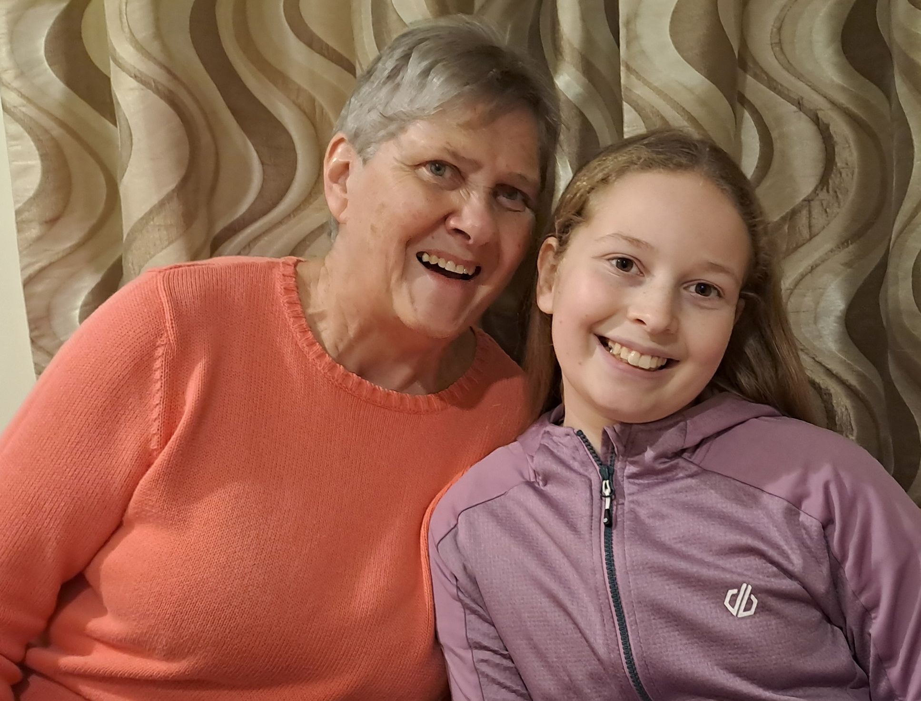
Perspectives of church representatives
‘walking history’
‘wonderful role models of faith’
‘they have a wealth of life experiences to share’
‘a depth of treasure to share with the church’
> Desire to increase awareness of this worth and potential more widely within local churches and Christian culture.

Slide 7
Awareness of obstacles
‘safeguarding puts them off’
‘I think they are a generation who feel that they are not permitted or allowed to’
‘there is often a lot of fear and worry about causing offence’
‘they seem to lack confidence in informal scenarios’
‘they are happy to answer and discuss faith when
asked direct questions but won’t necessarily
instigate it themselves.’

Slide 8
Church messages (Denominational websites)
Denomination | Use of ‘parent’ | Use of ‘grandparent’
Baptist Union | 594 mentions of ‘parent’ | 39 occasions. None about faith nurture.
Church of England | 257 mentions of ‘parent’ | 24 times, fleeting and unconnected with faith.
Church of Scotland | ‘parent’ used 309 times | 26 times, mainly in news items and obituaries.
Elim | ‘Parent’ used 150 times | Six uses, all news items.
Methodist Church | 20 mentions of ‘parent’ | ‘grandparent’ briefly used four times.
Presbyterian Church Ireland | ‘Parent’ used on 40 occasions | Once, unconnected with Christian nurture.
Salvation Army | 453 mentions of ‘parent’ | 13 times, all news stories, unrelated to faith nurture.
Church of Wales | ‘Parent’ used 13 times | No mention of grandparents.
United Reformed Church | ‘Parent’ used 68 times | No mention of grandparents.
NCGC 2026

Slide 9

49% of the grandparent participants said that they had no support from their church, with the others saying that they had prayer support.
NCGC 2026

Slide 10
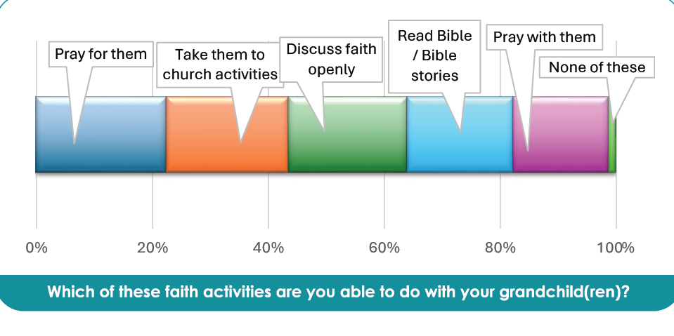

Slide 11
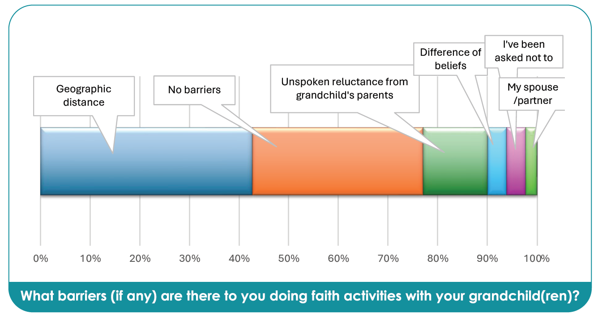

Slide 12
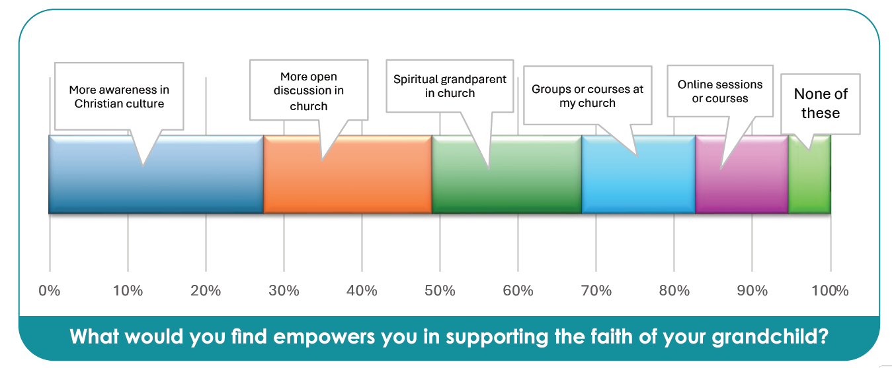

Slide 13
Discuss in groups of 3-5:
Does any of this resonate with you?
What challenges do you see in Christian families?
What reasons for hope have you seen?
CONNECTED • NCGC 2026

Slide 15
Facing the Challenges
AND Reasons for Hope
Becky Sedgwick & Sarah Holmes
• NCGC 2026

Slide 16
THE NATIONAL CHRISTIAN GRANDPARENTS CONFERENCE
NCGC 2026 • 05

Slide 17
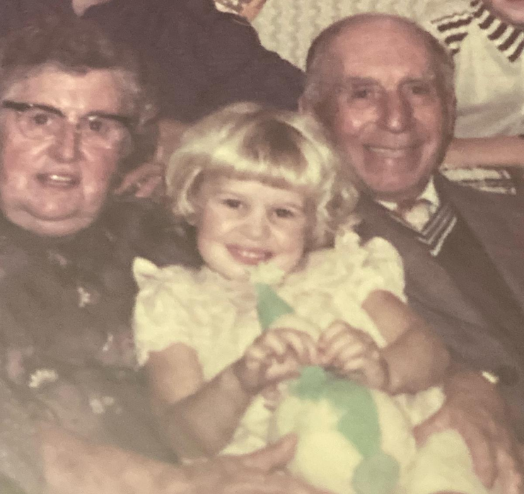
Are grandparents relevant?
THE NATIONAL CHRISTIAN GRANDPARENTS CONFERENCE

Slide 18
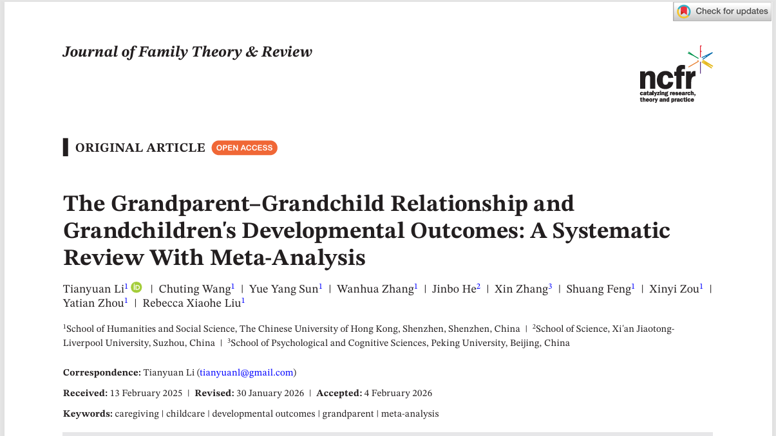
Are grandparents relevant?
Stronger bonds with grandparents are linked to better development
59 independent studies. 71,395 participants. A 2026 systematic review and meta-analysis brings the evidence together.
Better-quality relationships were associated with better psychological, social, behavioural, physical and cognitive outcomes for grandchildren.
The overall association was positive and statistically significant: r = 0.13 (p < .001).
The authors describe grandparents as playing a “constructive and dynamic role” in children’s development.
THE NATIONAL CHRISTIAN GRANDPARENTS CONFERENCE

Slide 19
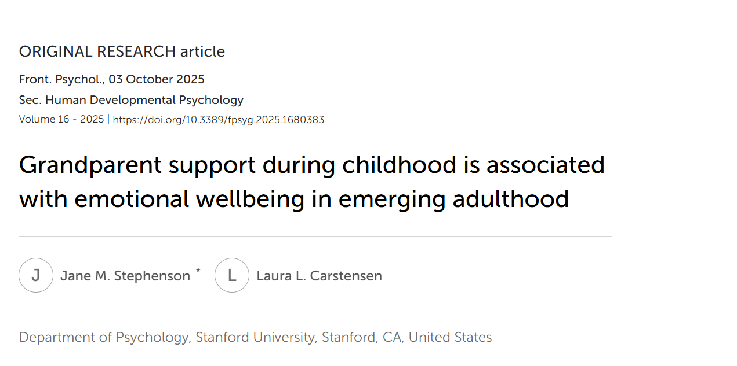
Are grandparents relevant?
Emotional wellbeing in young adults
A 2025 study of 514 young adults (aged 18-29) found that support from grandparents during childhood was associated with greater emotional wellbeing in emerging adulthood. The positive association remained even when grandparents had died before grandchildren reached adulthood.
THE NATIONAL CHRISTIAN GRANDPARENTS CONFERENCE

Slide 20
Are grandparents relevant?
Nine in ten teenagers report grandparent influence
One frequently cited study found that 9 out of 10 teenagers reported that their grandparents had influenced their values and behaviours. This statistic appears in your own presentation material and is widely used in discussions of intergenerational influence.
THE NATIONAL CHRISTIAN GRANDPARENTS CONFERENCE

Slide 21
Are grandparents relevant?
Grandparents help transmit family identity and values
Research consistently identifies:
Emotional closeness
Shared family identity
Storytelling
Social support
as important mechanisms through which grandparents influence grandchildren.
THE NATIONAL CHRISTIAN GRANDPARENTS CONFERENCE

Slide 22
Family is the biggest faith influence
Research with 1,001 young people by Youth for Christ found that 73% identified family as an influence on their faith and beliefs, compared with:
36% teachers and friends
23% TV and media
While the study did not isolate grandparents, it demonstrates the importance of familial influence, within which grandparents form a significant part.
THE NATIONAL CHRISTIAN GRANDPARENTS CONFERENCE

Slide 23
Why grandparents matter
Research suggests grandparents occupy a distinctive position because they often provide:
High warmth with less day-to-day discipline
Long-term stability
Emotional support
Family stories and identity
Wisdom from lived experience
Availability during family crises
Grandparent-grandchild relationships are frequently described as uniquely close and mutually satisfying
THE NATIONAL CHRISTIAN GRANDPARENTS CONFERENCE

Slide 24
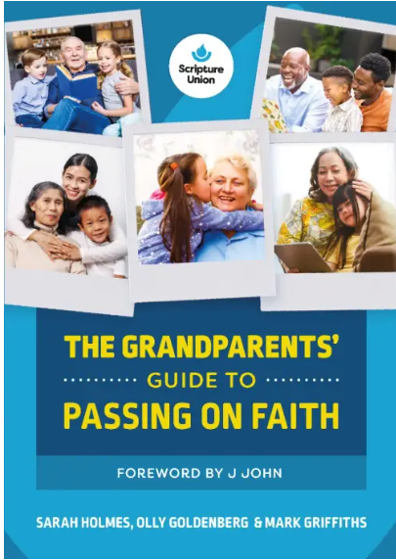
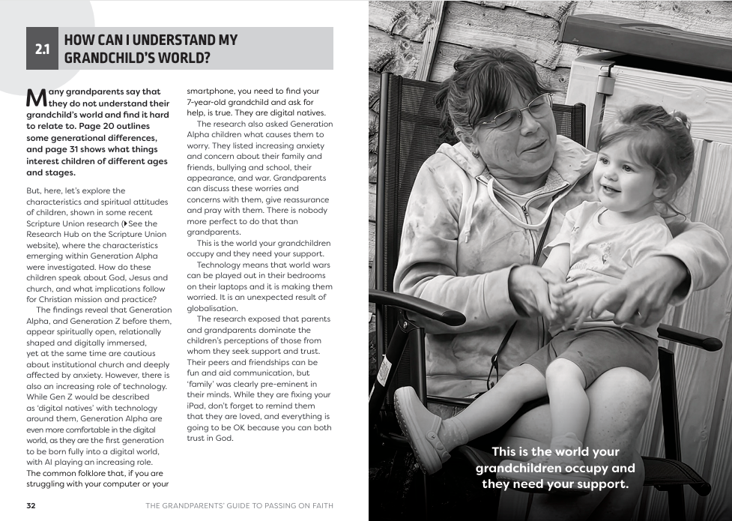
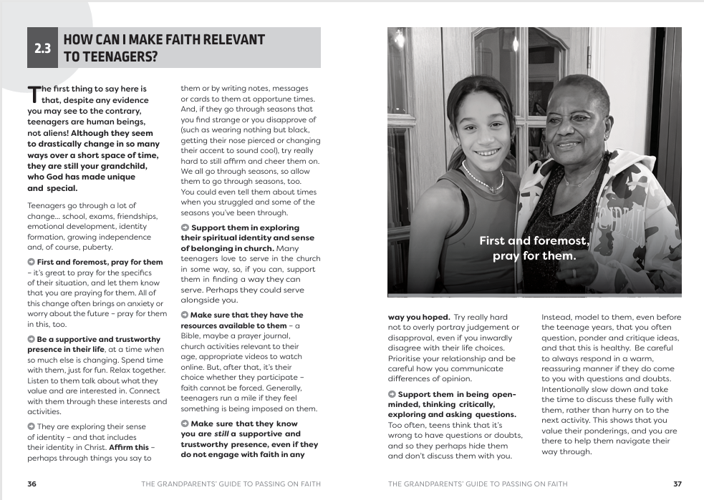
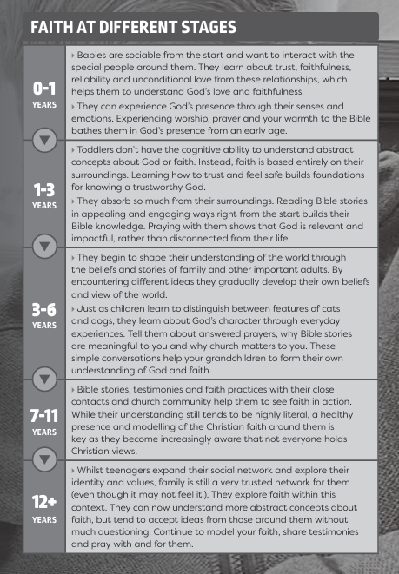
Are grandparents relevant?
THE NATIONAL CHRISTIAN GRANDPARENTS CONFERENCE

Slide 26

Reasons to hope
It’s not all down to you

Slide 27
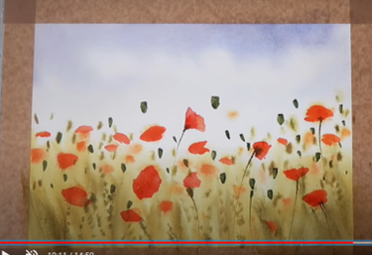
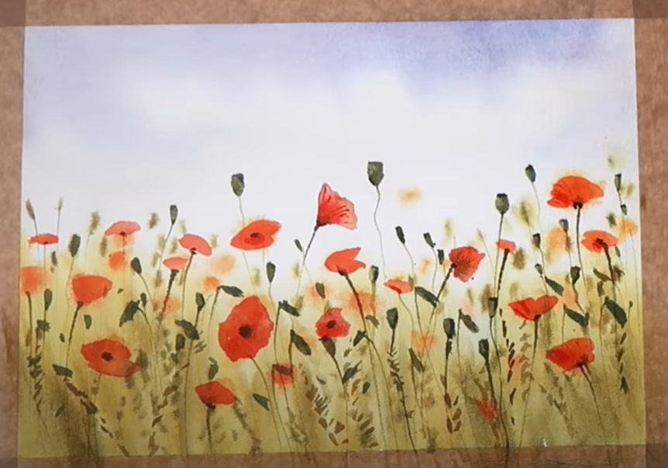
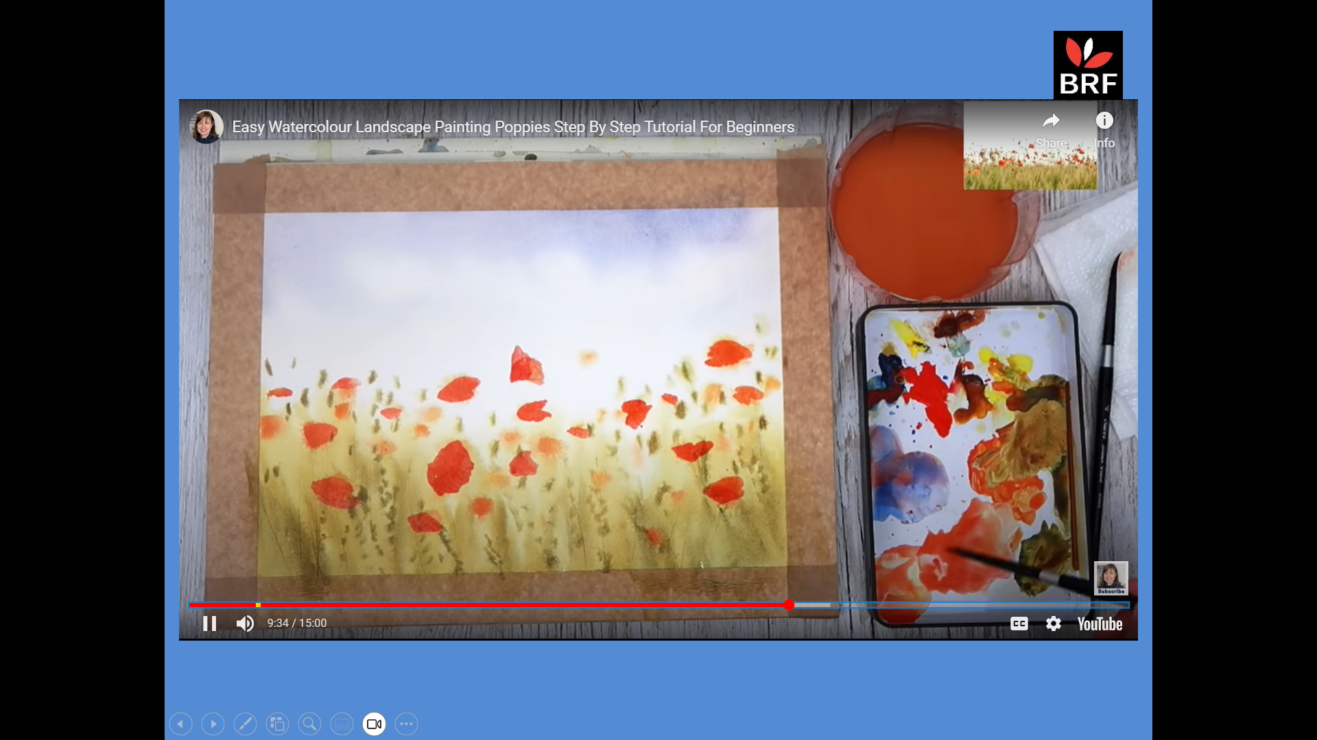
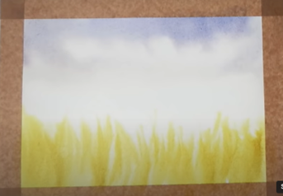
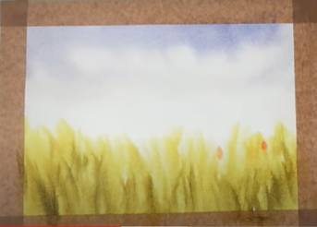
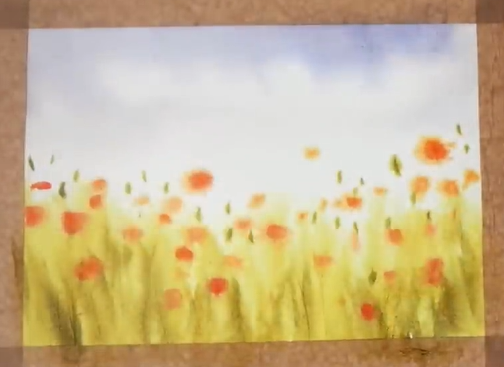
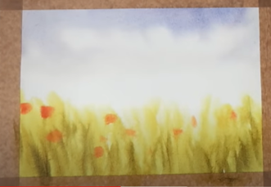
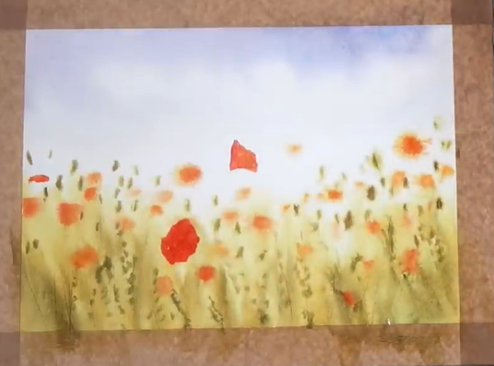
Notes:
One day I was watching a video of an artist creating a watercolour picture. This one taught you how to create a painting of a field of poppies. I watched, fascinated, as the artist dropped odd splatters of colours and dots here and there on the blurry canvas. Gradually, as different splashes were added and gaps filled in, all those individual spots and dots emerged into a coherent picture. What had started out as a seemingly random collection of marks on the canvas started to join up and reveal a beautiful and striking painting of poppies.
Discipling your grandchildren is simply about journeying alongside them and helping them gradually paint a picture of who God is. Every time you share a story about who God is, or point out what God is doing, or let your grandchildren see you connecting with God yourself, you’re dropping another splash of colour onto their canvas. Your job isn’t to paint the whole picture. It’s simply to add your splashes to the splashes God and others are putting on their canvas.
in our next session we’re going to be looking at some practical ideas you can use straightaway with your grandchildren. But I just want to say at this point: remember, it’s not all up to you. Even if your grandchildren’s parents aren’t on board, God is. He’s passionate about your grandchildren. He wants them to meet and know him. Don’t worry about how much or how little you can do. Your job is to keep asking God for your next steps in his plan for your grandchildren.

Slide 28
It’s not all down to you
Share with someone else:
What passion or hobby do you have?
Who got you interested in it?
What did they do?

Slide 29
It’s not all down to you
Sharing faith isn’t about telling your grandchildren everything they need to know.
It’s about adding your splashes to their canvas.

Slide 30
It’s not all down to you
You can only do what you can do – but God’s on the case.
Remember the poppies!

Slide 31
TIME FOR REFLECTION
07
What do you want to remember?
What would you say to
another grandparent to encourage them?
THE NATIONAL CHRISTIAN GRANDPARENTS CONFERENCE
NCGC 2026 • 07

Slide 32
THE NATIONAL CHRISTIAN GRANDPARENTS CONFERENCE

Slide 33
Lunch time!
THE NATIONAL CHRISTIAN GRANDPARENTS CONFERENCE

